Slide 1
Primary Admissions 2021

Slide 2
Diary dates
The application portal opens 15th November 2020.
Closing date for applications: 15th January 2021.
Primary school offer date: 16th April 2021.

Slide 3
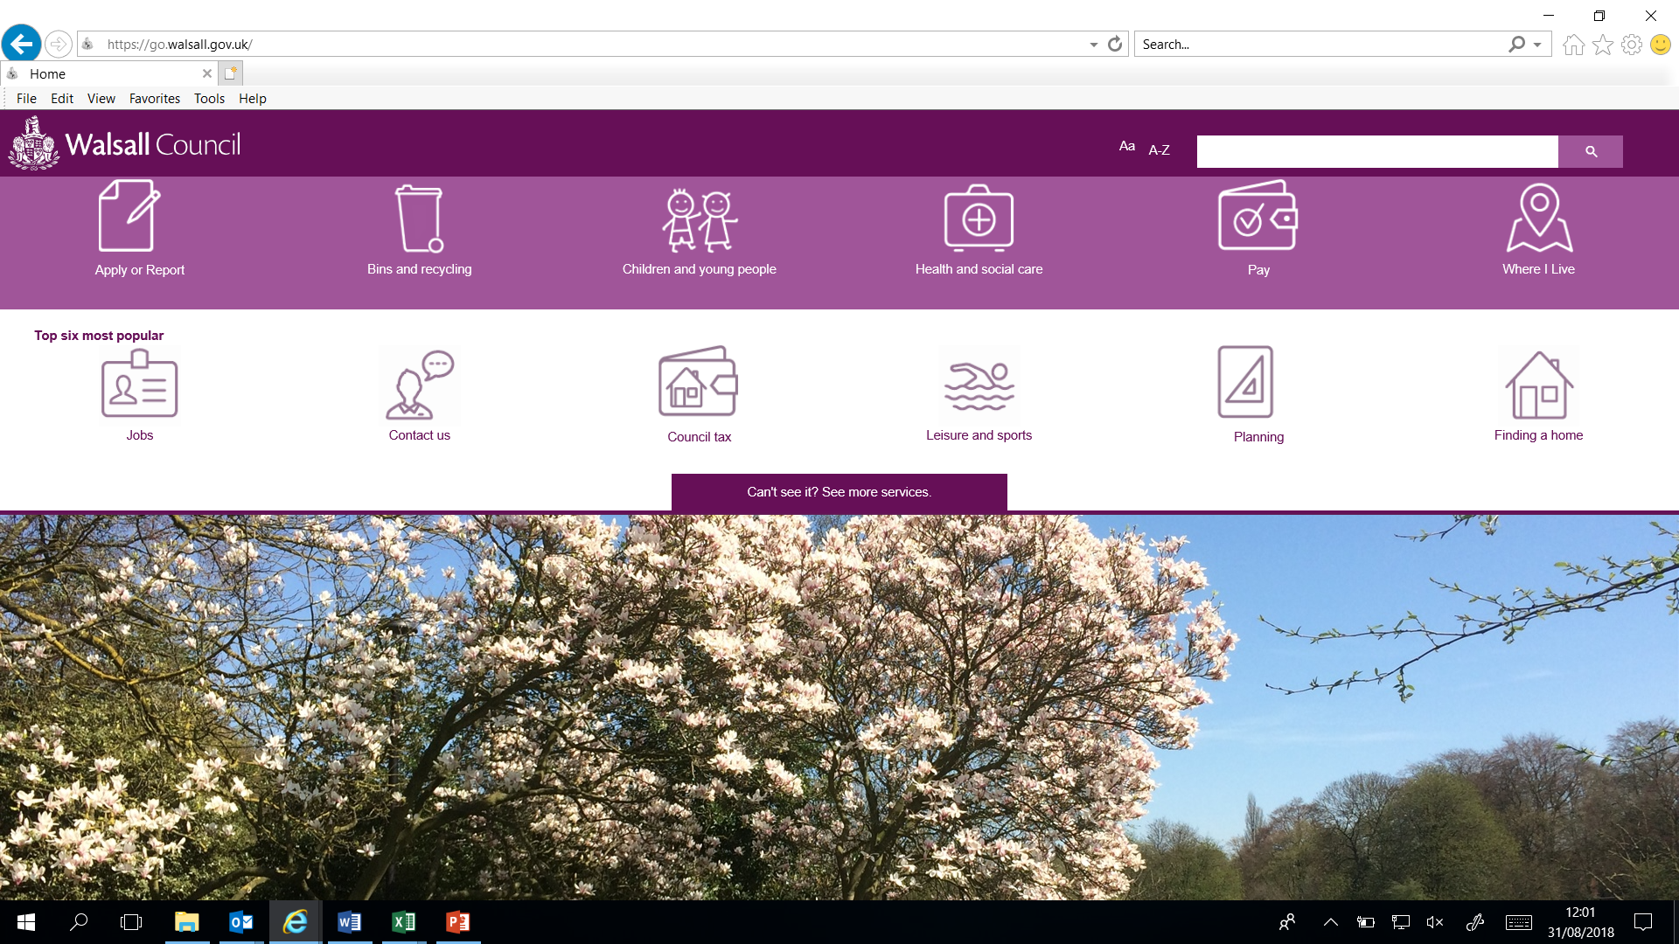
Applying online
Walsall residents must submit an online application.
You will need to visit the Walsall Council website.
Select ‘Can’t see it? Select more services’

Slide 4
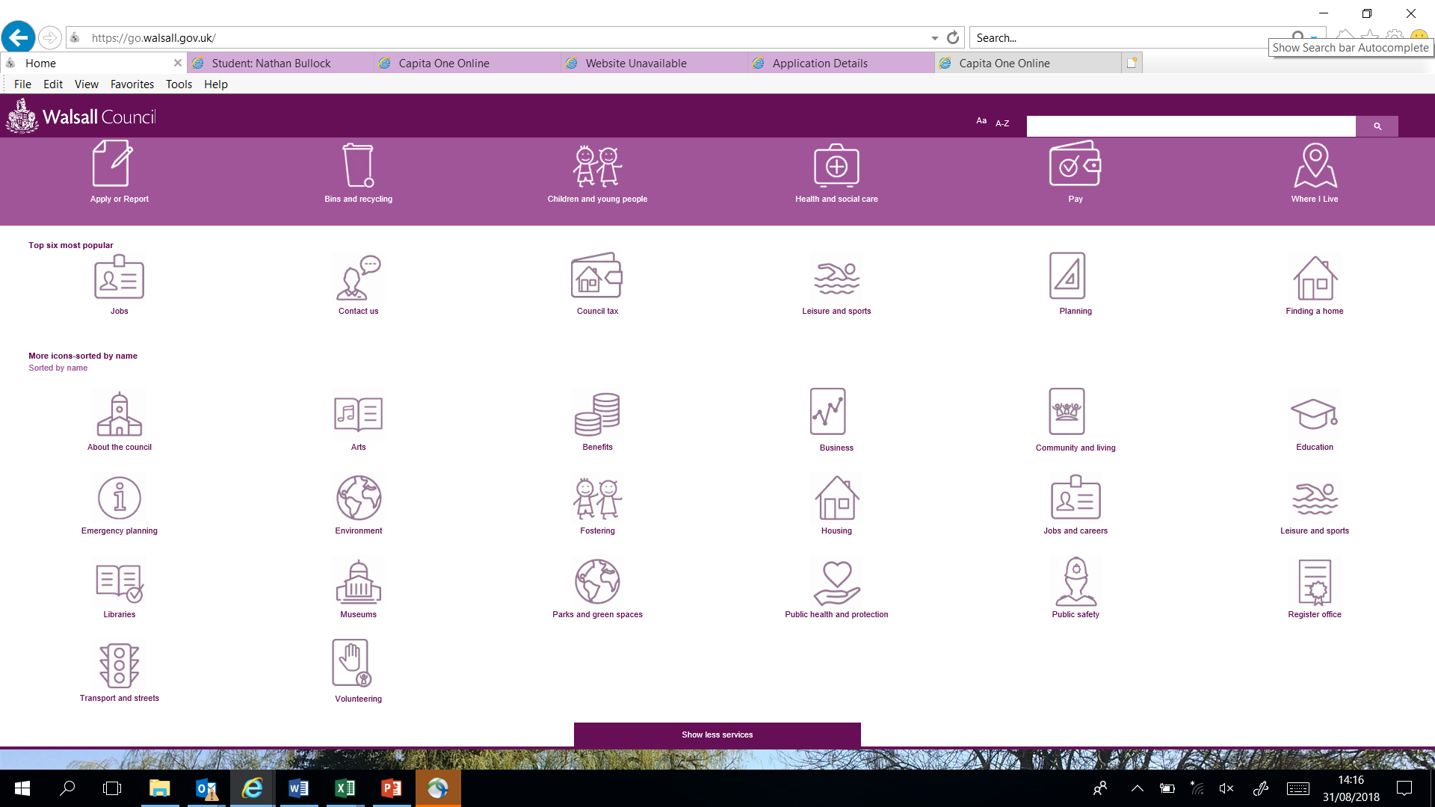
Applying online
Select ‘Education’

Slide 5
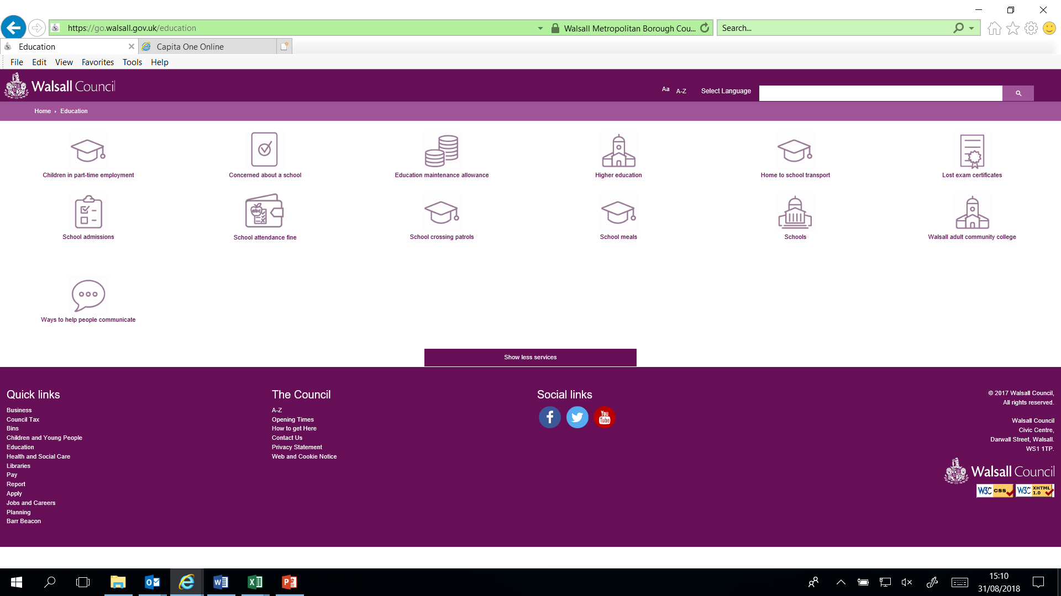
Applying online
Select School Admissions

Slide 6
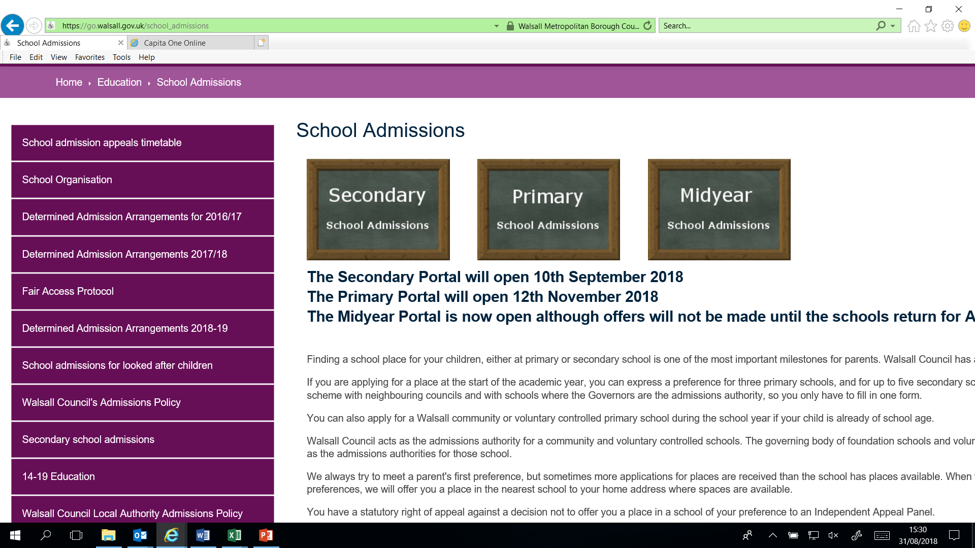
Applying online
Select Primary

Slide 7
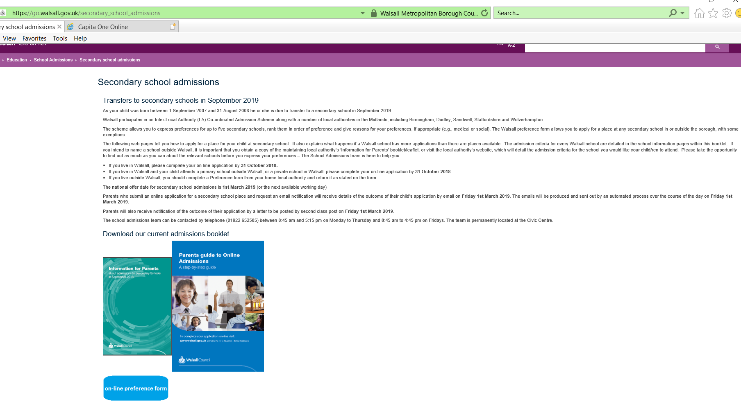
Applying online
Select ‘on-line preference form’

Slide 8
Applying online
Register and apply

Slide 9
Benefits of applying Online
Not a paper form.
Secure and safe system.
Your offer notification will be emailed to you.
16th April 2021 is offer day.
You can amend your application after it has been submitted up until the closing date of 15th January 2021.
Notes:
No need for a paper application form
Secure system so no one can view your application
You will receive email notifications about your account when submitting applications
You will receive an email on the 1st March with an offer of your child’s place
You can amend your application at anytime before the deadline however you must ensure the application has been submitted and that you’ve received a confirmation email

Slide 10
Top tips
Submit your application by 15th January 2021.
Do your research.
Read the information for parents booklet.
You have 3 school preferences, use them.
Include at least one local school that you feel your child would have qualified for in previous years.
If your preferred schools are oversubscribed, your child will be placed on a waiting list and the LA will allocate a place at the closest school with a vacancy.
Some schools require supplementary forms.
Notes:
Submit your application by 31st October 2018
Do your research; visit open days, read Ofsted reports, speak to the PSA’s and read through the information booklet.
On the information booklet you will be able to view how places were allocated for Walsall Schools in the previous two years
You have 5 school preferences, limiting your preferences to one school does not mean that you will be guaranteed an offer at this school.
If your preferred schools are oversubscribed, the Local Authority will place your child on a waiting list and will allocate a place at the closest school which has vacancies remaining
Some schools require supplementary forms – these are available to print on the portal. You must complete these and return to the schools directly

Slide 11
Result of a late application:
It is extremely important that you submit your application by 15th January 2021.
Late applications are processed after all those submitted on time.
Your child might not be offered a place at any of your preferred schools, even though you may live very close to the school and have other children attending there.
Your child could be allocated a place at an alternative Walsall school which may not be your most local, or one that you would have chosen.
It is unlikely that a place would become available at your preferred school from the waiting list.
Notes:
You may not be given a place at your preferred school
Even if you have another child at the school, you may still be put on the waiting list
Even if you live close to the school, you may still be put on the waiting list
If you do wish to appeal a late application, this will impact the outcome i.e. unsuccessful appeal
You may be given a school you least expect

Slide 12
Useful Information
Read the information for parents booklet
You MUST submit your application by 15th January 2021.
List 3 school preferences on your application.
Some schools require supplementary forms – they MUST also be submitted on time, directly to the schools.
Notes:
Submit your application by 31st October 2018
Do your research; visit open days, read Ofsted reports, speak to the PSA’s and read through the information booklet.
On the information booklet you will be able to view how places were allocated for Walsall Schools in the previous two years
You have 5 school preferences, limiting your preferences to one school does not mean that you will be guaranteed an offer at this school.
If your preferred schools are oversubscribed, the Local Authority will place your child on a waiting list and will allocate a place at the closest school which has vacancies remaining
Some schools require supplementary forms – these are available to print on the portal. You must complete these and return to the schools directly

Slide 13
Useful telephone numbers:
Use this website www.walsall.gov.uk/education to view/download the Primary Admissions booklet.
Email: schooladmissionsadvice@walsall.gov.uk
The Admissions and Appeals team aim to respond to all enquiries within 5 working days.

