Slide 1
Digital leaders 2022/23
Article 3 (best interests of the child) The best interests of the child must be a top priority in all
decisions and actions that affect children.
Article 16 (right to privacy) Every child has the right to privacy. The law should protect the child’s
private, family and home life, including protecting children from unlawful attacks that harm their
reputation.
Article 17 (access to information from the media) Every child has the right to reliable information
from a variety of sources, and governments should encourage the media to provide information that
children can understand. Governments must help protect children from materials that could harm
them.
Article 19 (protection from violence, abuse and neglect) Governments must do all they can to
ensure that children are protected from all forms of violence, abuse, neglect and bad treatment by
their parents or anyone else who looks after them.

Slide 2
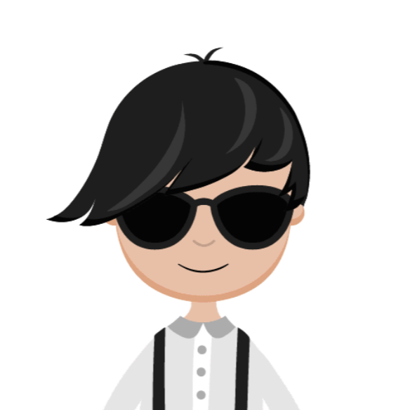
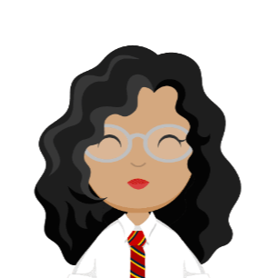
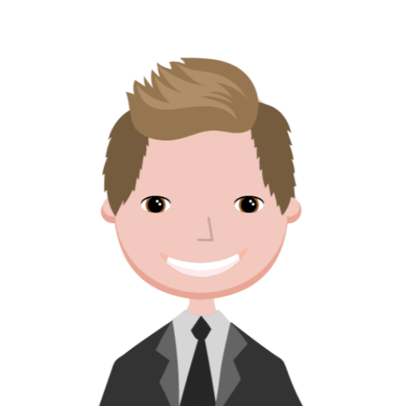
Who we are…
We will be presenting to you about:
Password security Age restrictions
What to do if you are scared online What your parent should do
Gurnoor
Aaron
Noah
Olivia
Aisha
Notes:
Hello and we are the digital leaders for St Giles Primary School. We will be talking about online safety throughout the year in assemblies and presentations to make sure you are safe at home and also at school and anywhere else. This should help you to understand what is the right thing to do and what should be avoided online. Think about the Convention on the Rights of a child and the articles that link to ‘Online Safety.’

Slide 3
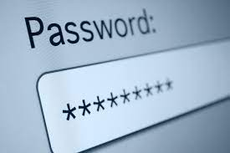
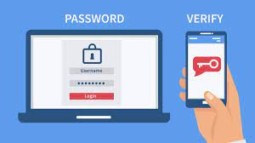
Password security
Passwords are very important and you need them to keep you safe.
Do you know if your password is safe?
Notes:
Your passwords should never be simple but make it easy to remember because if it is to complicated then you will forget it easily. Make sure you do not use the same password for everything. In passwords you should have: numbers, letters and symbols or a 2 step verification password that sends a code to your email. You can use face ID , A Fingerprint password, or a more complicated password . A good password is : batman5437£ And a bad password is : 1234 and password.

Slide 4
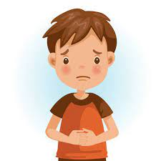
What to do if you are worried, scared or sad…
Notes:
If you are worried,scared or sad you can tell a trusted adult , your teaches or you could tell us your digital leader’s and child line or ceop. But if you tell us the digital leader’s if we think that a teacher should know we will tell them because some things we need to tell an adult about if it is concerning.
If you are in serious danger online you could also tell the police about it.

Slide 5
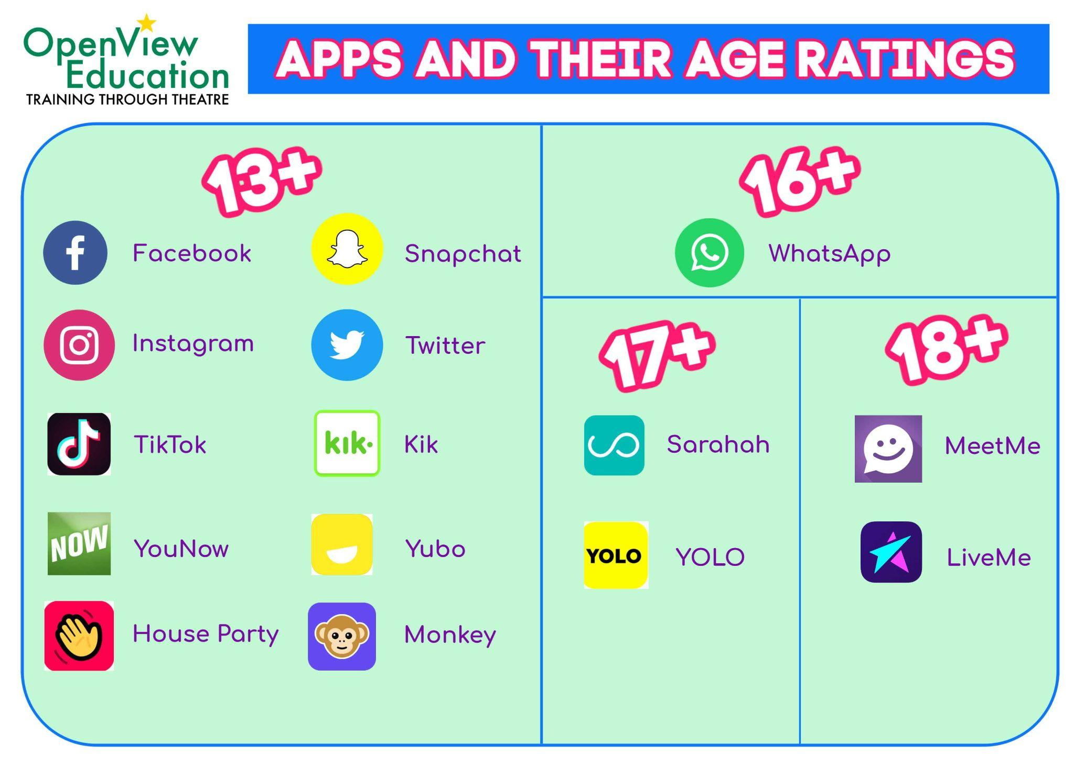
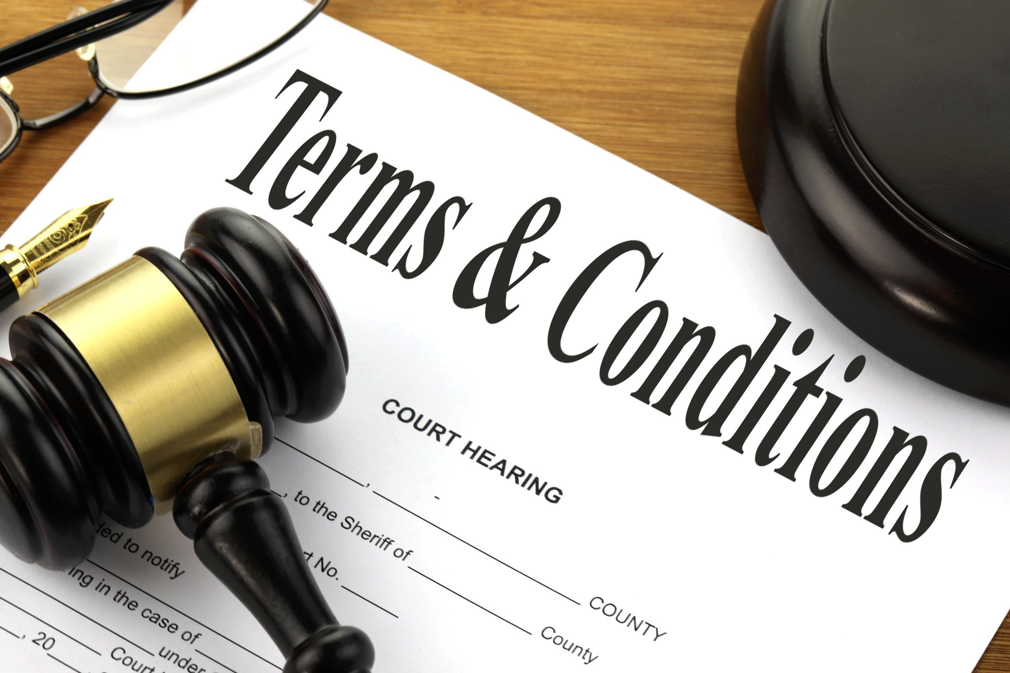
Age restrictions…
Do you know the age restrictions of the apps/websites you use?
Notes:
So many of you would have probably completed our survey. One or two of the questions talked about the age restrictions of many social media platforms and most of you chose the right option to make sure that you are safe. Most social media platforms age restrictions are above 13. Many of you might also use an app called youtube. But do you actually know the age of which you’re meant to access this app? Well, you’re meant to be 13 or over due to the personal information the app will collect such as location, viewing habits and searches.
What would you do when a terms and conditions pop up on your screen about the age restrictions?
Would you just ignore it and accept?
(please be honest while thinking about this)

Slide 6
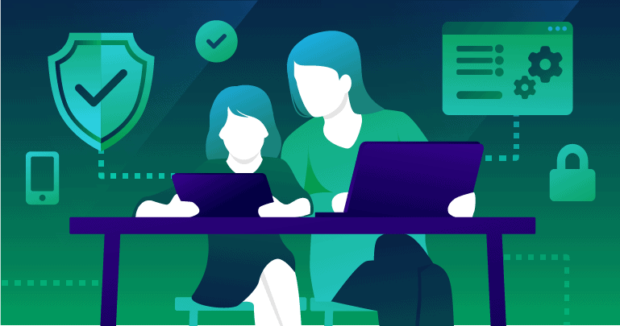
What your parents should do…
Give permission to their children.
Parents checking their child’s online life for safety purposes.
Explain why they can’t go on some websites .
Notes:
An important role in online safety is having a duty bearer. This means you’re parents, teachers and any one who takes care of you. Duty bearers have very important responsibilities and they should give you permission to any social media applications or not as well as needing to also teach you how to report people but also listen to you if someone bullies you or just picks on you online.

